Slide 1


Image Transmission and Encryption using RC4 Algorithm through Optical Network
By: Sajjad Leith Mohammed
Supervisor: Asst. Lect. Azhar Hussein Neama

Slide 2
Outline
Introduction
The Aim of the project
Problem Definition
Project initial phase
Conclusion

Slide 3
Introduction
Image encryption has a wide area of application by using different encryption algorithms. Unlike the text encryption, image encryption suffers from redundancy in the plaintext which represents a problem that should be faced. In this paper, a gray-level image encryption is implemented by using RC4 algorithm. RC4 is stream cipher algorithm and it’s popular in WEP(Wired Equivalent Privacy) , RC4 was created by Ron Rivest of RSA Security in 1987. After program execution and results assessments, we found that the encrypted image is resistant to several types of cryptanalysis, and it shows a high level of randomness in the cipher text. Also, the encrypted image has passed the FIPS 140 randomness tests.

Slide 4

The Aim of the project
With the high development of communication and Internet technology; the need raised to have a secure communication to exchange confidential information, such information could be audio, video, or image files. One way to have such secure communication is to change the shape of the transmitted data; which is called encryption. In the encryption process, the data is encrypted by using an encryption method and secret key. The RC4 encryption algorithm is used to encrypt an image data file (gray level image); this method is widely used in WEP. After the implementation of this algorithm; the encrypted file is analyzed and subjected to many tests. The encrypted file showed good results during these tests.

Slide 5

Problem Definition
The biggest problem that faces image encryption and does not exist in text encryption is the redundancy in plaintext. Therefore the used algorithm must give high distribution pixels for the cipher text image so that the attacker cannot extract any useful information from it.

Slide 6

Methodology
The tool that I will used is Matlab to do encryption ,decryption & transmission.

Slide 7
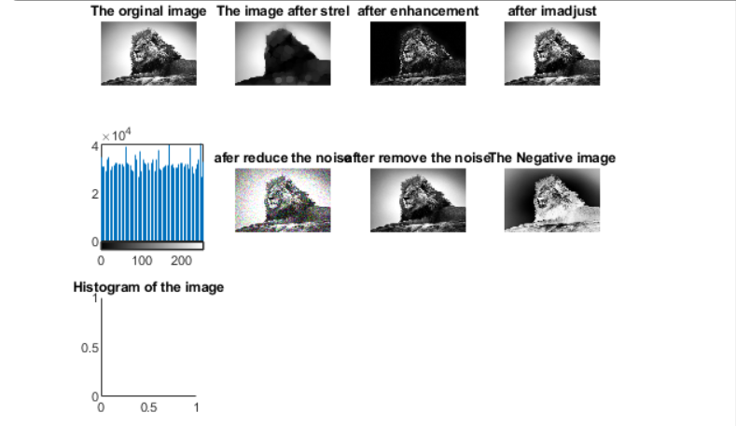
Project initial phase
I have done image processing to the image and made encryption to the image by using RC4 in matlab.
1- Image Processing

Slide 8
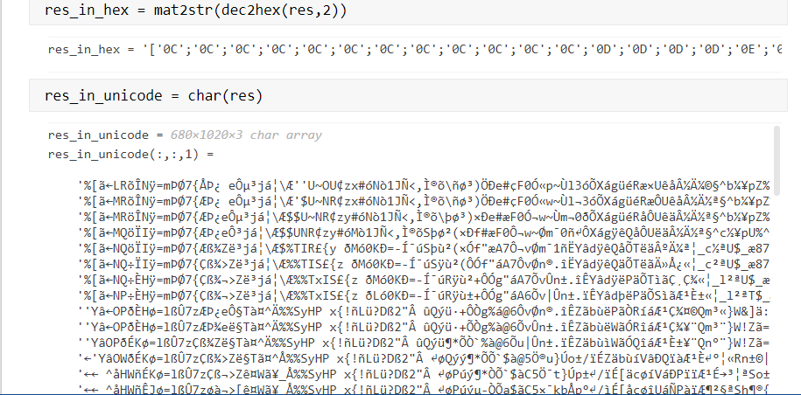
Project initial phase cont.
2- Encryption by RC4 for the image :

Slide 9
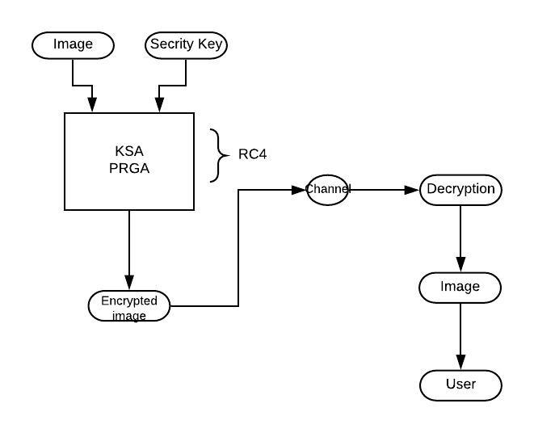
Diagram for image encryption

Slide 10
Gantt Chart
Jul | Jun | May | Apr | Mar | Feb | Jan | Dec | Months
 |  |  |  |  |  |  |  | Tasks
 |  |  |  |  |  |  | ✓ | Studding and searching for resources
 |  |  |  |  |  | ✓ |  | Get image and do image processor using matlab
 |  |  | ✓ | ✓ | ✓ | ✓ |  | Coding using matlab to do encryption by RC4
 |  | ✓ | ✓ |  |  |  |  | Execution
✓ | ✓ | ✓ |  |  |  |  |  | These Writing

Slide 11

Conclusion
First in my project I have done image processing .
Second ,image encryption by RC4.
In the future ,I will send the encrypted image to the channel and in the channel the receiver will have the encrypted image just decrypt to the image and he/she will has the information that he/she wants.

Slide 12

Thanks for your attention

